Slide 1

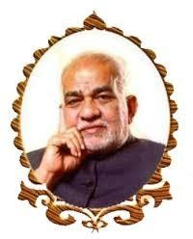
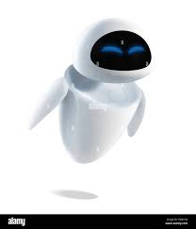
MEDHANVESH 2023
CHATGPTHON
COMPANION BOT
Team No:12
M.PRAGNITHA : 21WH1A1240
P.L.VARSHITA : 21WH1A1218
K.AMRUTH CHARAN REDDY:21071A12F3
Medhanvesh 2023 ChatGPThon

Slide 2
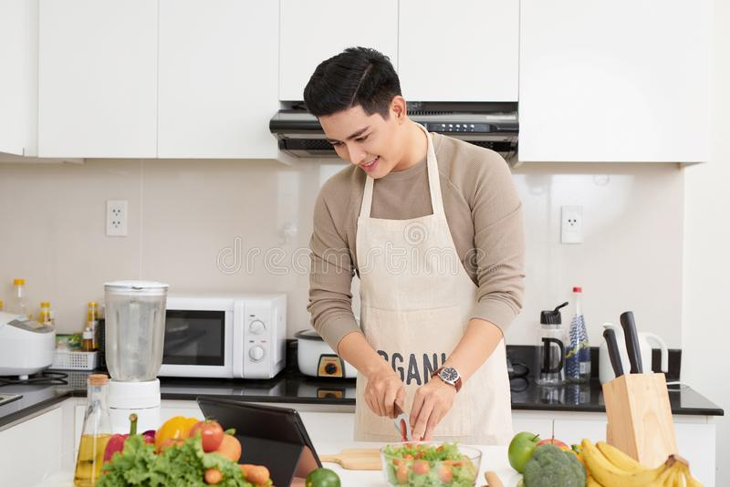


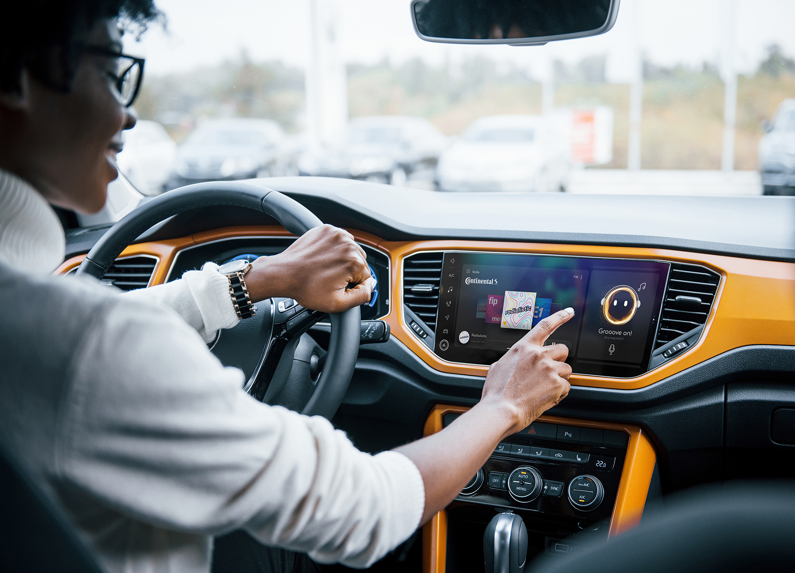
Abstract
The proposed bot is a versatile AI-based conversational agent that can engage in conversations, tell stories, provide recipes, and share motivational quotes. The bot leverages Natural Language Processing (NLP) algorithms to generate engaging stories and conversations while providing an intuitive user experience.
The recipe feature allows users to receive cooking instructions for various dishes. Additionally, the bot includes a motivational quote feature to uplift and inspire users. With a comprehensive database of stories, recipes, and quotes, the bot can provide a diverse range of content to suit the user's preferences. This bot can be an excellent companion for those who enjoy storytelling, cooking, and self-improvement.
Medhanvesh 2023 ChatGPThon

Slide 3
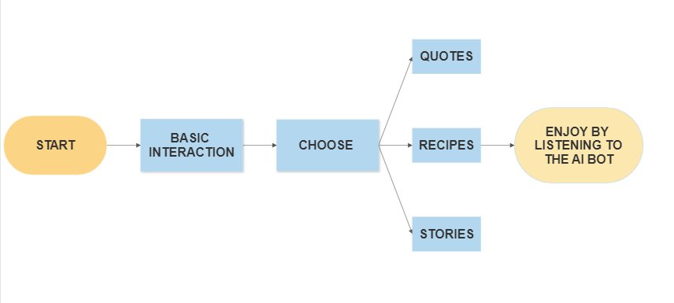
ARCHITECTURE
Medhanvesh 2023 ChatGPThon

Slide 4
HOW TO USE
Introduce yourself to the bot.
Tell the bot whether you want to listen to a recipe or a story or some motivational quotes.
you can enjoy by listening to the bot.
If you want you can continue talking to it.
you can say bye to exit.
Medhanvesh 2023 ChatGPThon

Slide 5
DESIGN AND TECHNOLOGIES
NATURAL LANGUAGE PROCESSING
PYTHON
TEST-SPEECH USER INTEFRACE DESIGN
TKINTER GUI
spaCy
Medhanvesh 2023 ChatGPThon

Slide 6
REFERENCES
https://chat.openai.com/chat
https://www.geeksforgeeks.org/introduction-to-natural-language-processing/
https://www.geeksforgeeks.org/convert-text-speech-python/
https://www.kaggle.com/datasets/manann/quotes-500k?resource=download
https://blog.reedsy.com/creative-writing-prompts/

Slide 7


